Slide 1
Copyright & Fair Use
CLICK ABOVE
Educators | It’s not what you may think …

Slide 2
What is Copyright?
A law that gives you ownership anything you create
The creator of the work has the exclusive right to:
Reproduce the work
Prepare derivative works
Distribute Copies
Preforms the work
Display the work publicly
No one can legally violate your rights
CLICK ABOVE

Slide 3
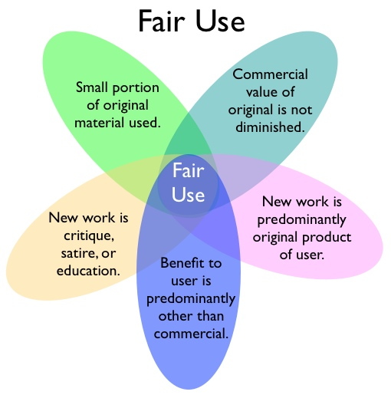
What is Fair Use?
SEE THE PERVIOUS SLIDE ON COPYRIGHT
Fair use allows people other than the copyright owner to:
Reproduce the work
Prepare derivative works
Distribute Copies
Preforms the work
Display the work publicly --- Fair use is only just a limitation on this right

Slide 4
Educators & Fair Use
“This is going to be too difficult to follow as a teacher”
“I don’t have the time to really check to see if I am legally compliant”
“No one really cares about this when I use it in my classroom”
“What else do I need to check for my lesson plans now?”
IF THERE ONLY WAS A WAY TO MAKE THIS EASIER TO FOLLOW ALONG …

Slide 5
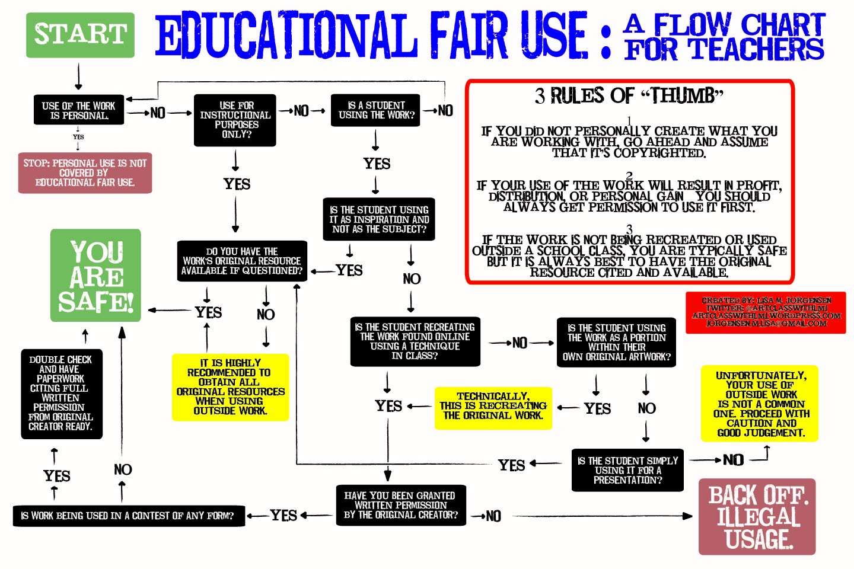

Slide 6
Some Scenarios?
What if I want to do this?
What if I want to show the entire show?
What if this happened and I posted it online?
What if I do break the law, accidently of course?
What if I tried to follow the rules but didn’t end up following the rules?

Slide 7
Scenario One
A student chooses to make a multi-media presentation and uses video from YouTube or another online source. Is this okay and in the Fair Use guidelines?
YES! Well, sort of… A student may use “portions” of copyrighted works in their academic presentations, as long as the video is of 10% or less of the original work or less than three minutes (which ever is less).

Slide 8
Guidelines of Scenario One
Below is a section taken from the Copyright and FairUse Guidelines for Teachers

Slide 9
Scenario Two
A teacher is online all of the time and uses it to find images, audio, and video files for his lessons. Is this teacher actually allowed to do this?
YES! Well, sort of… Teachers may download images, audio, and video files for student projects and teacher lessons. Be sure to re-read the last slide in reference to the audio and video downloads.

Slide 10
Guidelines of Scenario Two
Below is a section taken from the Copyright and FairUse Guidelines for Teachers

Slide 11
Scenario Three
Am I allowed to show movies (even though my administration frowns upon it) for student rewards days. These movies are linked to standards though!
YES! Well, sort of… You, as a teacher, have the opportunity to show any movie legally acquired and
it follows your district’s guidelines for videos in the classroom
Feel free to make a copy for archival purposes or replacement

Slide 12
Guidelines of Scenario Three
Below is a section taken from the Copyright and FairUse Guidelines for Teachers

Slide 13
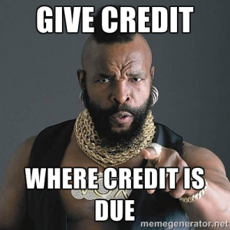
If All Else Fails
I PITTY THE FOO WHO DOESN’T

Slide 14
Resources
Bailey, J. (2005, August 16). 1. What is a Copyright? Retrieved June 16, 2015, from https://www.plagiarismtoday.com/stopping-internet-plagiarism/your-copyrights-online/1-what-is-a-copyright/
Copyright and FairUse Guidelines for Teachers [Online image]. (2013) Retrieved June 16, 2015 from http://edudemic.com/wp-content/uploads/2013/02/teachers-copyright.jpg
Educational Fair Use: A Flow Chart For Teachers [Online image]. (2012) Retrieved June 16, 2015 from https://artclasswithlmj.files.wordpress.com/2012/11/fair-use-map.jpg
Starr, L. (2010, May 25). The Educator's Guide to Copyright and Fair Use. Retrieved June 16, 2015, from http://www.educationworld.com/a_curr/curr280.shtml
Teaching Copyright. (n.d.). Retrieved June 16, 2015, from http://www.teachingcopyright.org/handout/fair-use-faq

