Slide 1
Mobile APP Learning
S6C20
VIEW THIS PRESENTATION ONLINE @ EMAZE.COM
Emerging Technology
Chad J. DeWolf
ITEC 7445
Dr. Chiavacci
June 25, 2015

Slide 2
APP | Video Intro for All

Slide 3
Como.com – Our APP Solution
Como has everything we need to customize and manage own APP, engage our users, and connect our students to learning in a 24/7/365 environment.
We can create our own APP
No technical skills are required
Will be teachers Content Management Solution
Connects all stakeholders

Slide 4
What is Como? Explained!

Slide 5
What can Como actually provide?
Mobile Commerce
Student Coupons
Calendars
Loyalty Programs
About Section
Click to Call
Directions & Maps
User Reviews
Collections & Catalogs
School Menus
School Events
Share The App
Show an RSS Feed of Info
Social Feeds (Facebook, Twitter, Instagram…)
Video Gallery (YouTube, Vimeo…)
Photo Gallery (Instagram, Picasa…)
Music & Audio
Advanced Analytics
Monetization Possibilities
Promotional Tools
USER ENGAGEMENT
Push Notifications
Sharing of Content & Media
Reports & Forms
Mailing Lists

Slide 6
Idea Behind Mobile Learning
People are glued to their mobile technology
Computers are in the pockets of our students
Makes sharing of standards based content easier for teachers and more accessible for students and parents
The mobile student network is already in place for this to occur

Slide 7
Madison County School District MISSION & VISION
S1C1
MISSION
Graduating Independent Productive Citizens
VISION
The vision of Madison County Schools, the pinnacle of the community’s commitment to progressive excellence in education, is to ensure that each student achieves personal aspirations while optimizing their unique talents and exemplifying the community’s high moral values through a system distinguished by
Active student learning within a rigorous curriculum
Exemplary staff who are caring and supportive
Learning environments that conform to the needs of individual students
Pride and unity in our schools and community

Slide 8
Como Catapults our Vision
S1C1
Como supports the district’s vision of
Progressive excellence in education
Each student achieves personal aspirations
Active student learning within a rigorous curriculum
Supportive staff who cares about life long learners
Conforms the learning environment to each student – wherever and whenever
Pride & unity in our schools & community

Slide 9
APP – The General Purpose
To give all stakeholders, especially students, access to standards based content
Allow teachers an easy drag and drop solution for sharing standards based lessons
Utilize the power of social media and reach all stakeholders immediately
Engage students throughout their academic careers – inside and outside of our walls

Slide 10
APP Access & Design
S1C9
APP can be designed for elementary, middle, and high school students
Load access to APP on all district mobile technology (iPads, handhelds)
Load access to APP in all computer labs and on all district employees computers
Platforms (Where will the APP work?)
iOS (Apple)
Android (Google Play)
Website on any computer with Internet
--- Pretty much anywhere with internet access

Slide 11
Equipment | Software
S3C11
Use already purchased computers and tablets
NO need for additional purchases

Slide 12
Technical Support? Professional Learning?
S3C12 | S5C19
Como provides many resources for those that will be project managers of the APP.
http://www.como.com/tutorials/
https://www.youtube.com/user/ConduitMobile/playlists
The school will have a designated person that will manage the app. Teachers will not need to know anything about the app itself and will never login to update.
Little to NO professional development is needed All teacher information is through their Google for Education accounts.

Slide 13
Limitations
S3C13
Students will need to have access to either a smartphone, tablet, or the internet.
Not a 100% solution for each student.
Requires internet connection at all times.

Slide 14
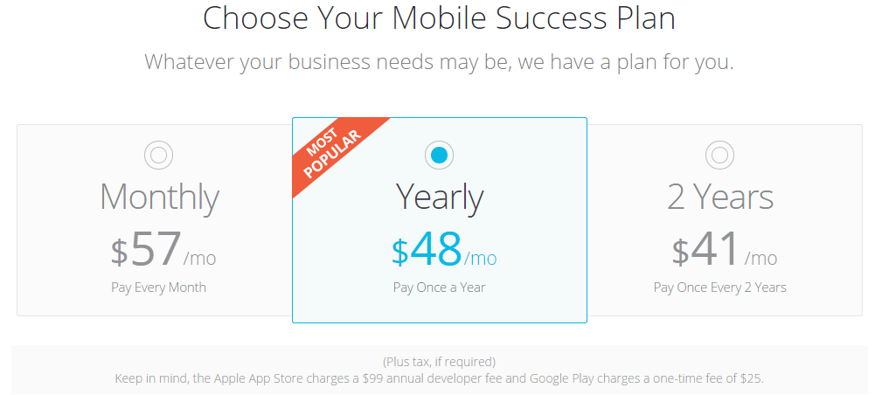
Cost of The APP
S3C14
There are four options for pricing. The three below are not options for us. The next slide is our cost.

Slide 15
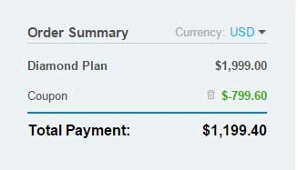
Actual Cost of the APP
S3C14
There is a ONE TIME FEE of $1,999.00
A coupon worth $799.00 comes in email advertisements every so often
TOTAL ONE TIME COST = $1,199.40

Slide 16
Yearly Service Cost
S3C14
APP will be hosted in iTunes and Google Play for user downloads.
iTunes = $100 per year
Google Play = $25 one time fee

Slide 17
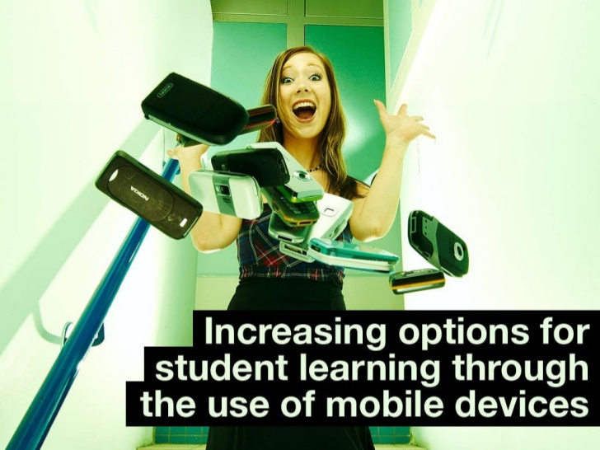
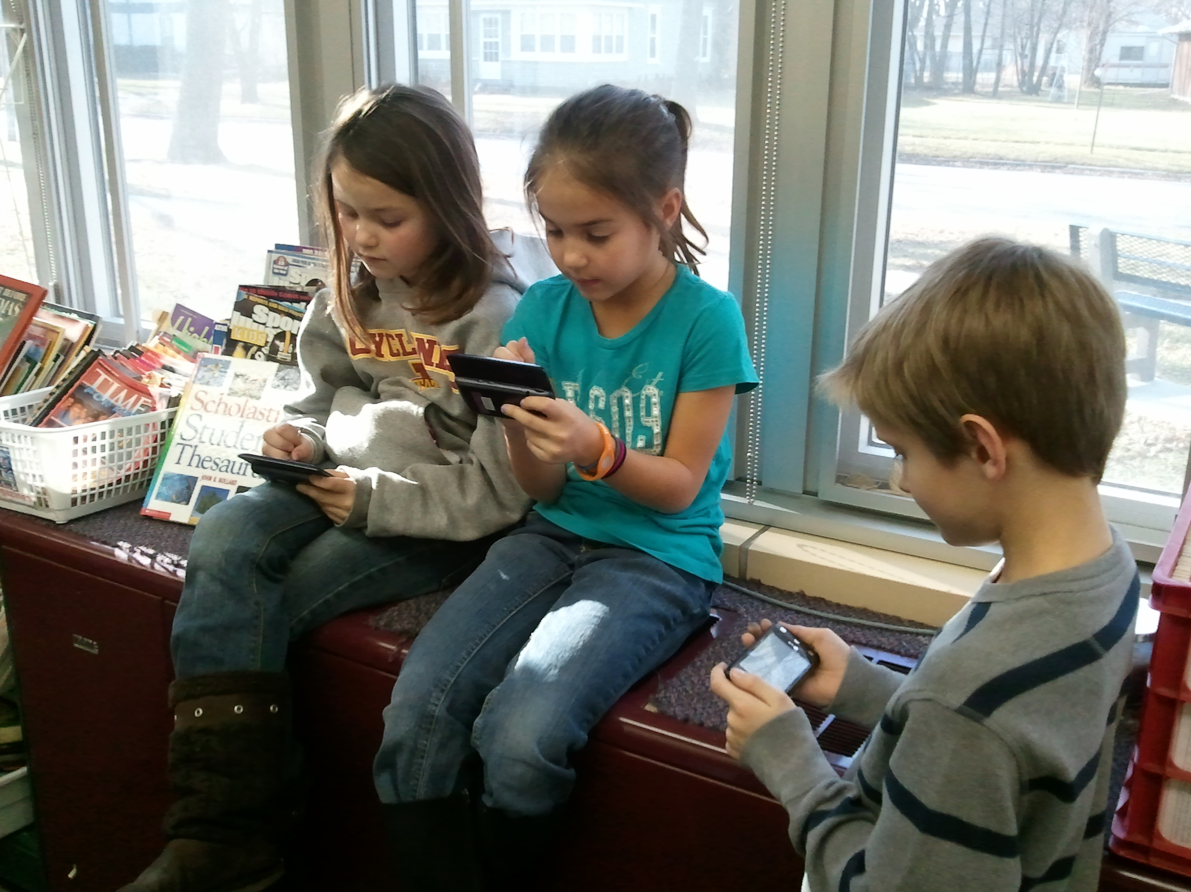
Funding for APP
S1C3
Just a one time fee of just over $1,000.00
Yearly cost through iTunes = $100.00
Our can easily fund this technology fund
We are not paying for just an APP

Slide 18
Implementation Process
S1C2
District purchases
App, iTunes account and Google Play account
Project manager at school sets up APP
Project manager instructs Team Leaders on how to manage content/lessons in Google Accounts
Team Leaders train their content teams
APP is loaded onto school devices and student personal devices
Integrate the endless possibilities this APP solution offers the student learners

Slide 19
Usage by Classroom Teachers
S2C4 | S2C5 | S2C6 | S2C7 | S2C8 | S3C10 | S3C16
Content & Technology Standards | Learning Goals | Collaborative & Authentic Learning | Project-based Learning | Writing & Reading & Listening Processes | Differentiation | Communication with ALL Stakeholders

Slide 20
Getting On Board the APP Train
Incentivize teachers and students to download and install the APP
Meet with teachers who are unsure of what to do or who have questions
Celebrate the movement of the school to an online platform for APP learning

Slide 21
Safe, Healthy, Legal & Ethical Issues
S4C17
Internet MUST have a filter, but should already
Copyright issues may arise – training needed?
Student online safety while using their own devices needs to be monitored as it already states in the Bring Your Own Technology contract

Slide 22
Diverse Needs of ALL Students
S4C18
ATHLETES – Can now study on the way to and from a sporting event
BUS RIDERS – Can now study on the way to and from school
SPECIAL NEEDS – Can now access content never presented before
GENERAL ED – Can now have access to content and work as a self-regulated learner
GIFTED & ADVANCED – Can now move ahead and access future content as a means of acceleration

Slide 23
Research on Emerging Technology
S3C15
On average, students who used computer-based instruction scored at the 64th percentile on test of achievement compared to students in the control conditions without computer who score at the 50th percentile.
Students learn more in less time when they receive computer-based instruction.
Students in technology rich environments experienced positive effects on achievement in all major subject areas
(Schacter, 1999)

Slide 24
Research on Emerging Technology
S3C15
Students in technology rich environments showed increased achievement in preschool through higher education for both regular and special needs children.
Consistent student access to the technology, positive attitudes towards the technology (by both teachers and students), and teacher training in the technology led to the greatest student achievement gains.
(Schacter, 1999)

Slide 25
Research Summary
S3C15
All studies show that in over 700 empirical research studies, in the study of the entire state of West Virginia, in a national sample of fourth and eighth grade students, and in an analysis of newer educational technologies that students with access to
Computer assisted instruction, or
Integrated learning systems technology, or
Simulations and software that teaches higher order thinking, or
Collaborative networked technologies, or
Design and programming technologies,
Show positive gains in achievement on researcher constructed tests, standardized tests, and national tests.
(Schacter, 1999)

Slide 26
Reflection | Emerging Technology
S6C21
Initially I thought that an app would be a great tool for my classroom and for my students. I shortly realized that if this could be made for my needs, why not for all teachers in our school?
Students now have one place to go for all of their academic needs and parents can now assist in ways they never thought were possible. I love this aspect about the app.
I am always looking for new and innovative ways to reach my students and connect with the school community. This, makes that, easy!

Slide 27
Works Cited
S6C20
Schacter, J. (1999). The Impact of Education Technology on Student Achievement. Retrieved June 23, 2015, from http://www2.gsu.edu/~wwwche/Milken%20report.pdf

